Slide 1
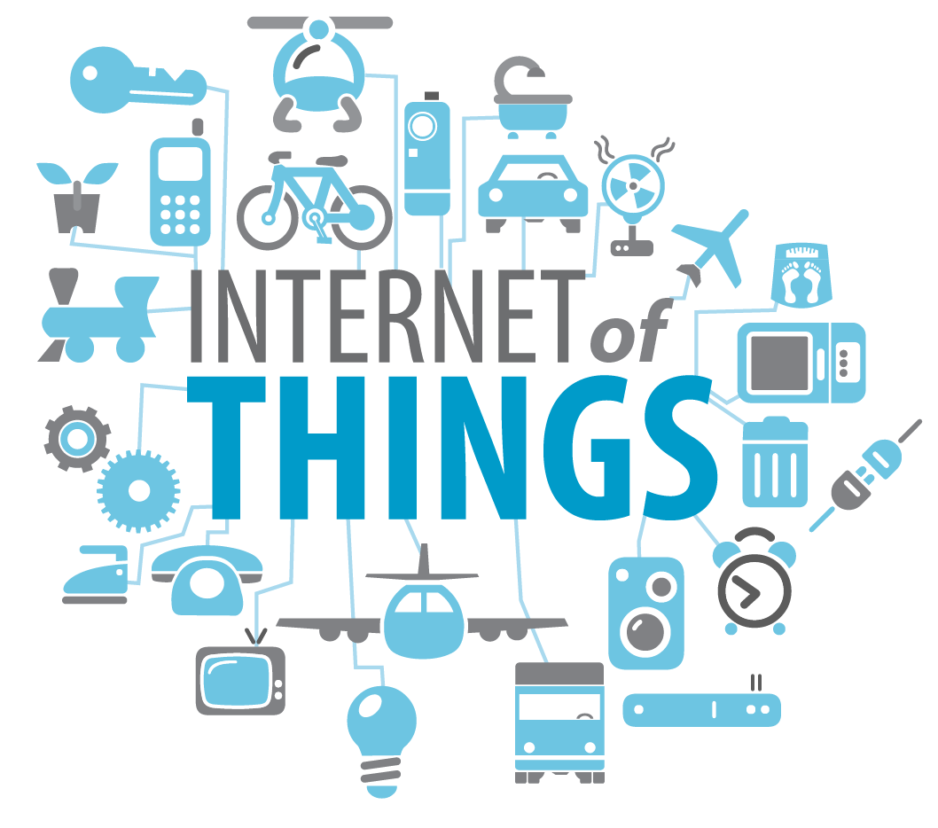

IoT based Appointment & Location Application
Guided by: Dr. Jiangjiang Liu,
Dr. Bo Sun,
Dr. Stefan Andrei
Presented by:
Aksh Patel - L20405163
Bhumit Patel - L20382154
Nikul Patel - L20400583
Department of Computer Science

Slide 2
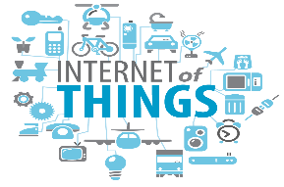
Outline
Introduction
Motivation
Related Work
Design & Implementation
Test Case
Project Demo
Future Work
Conclusion
Bibliography
Department of Computer Science

Slide 3
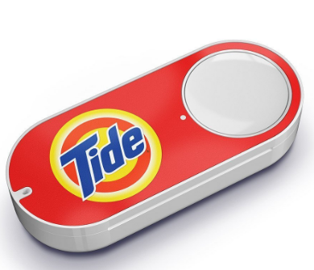
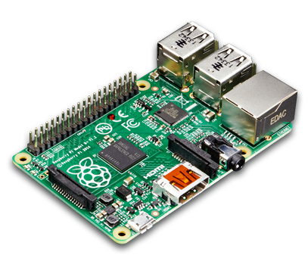
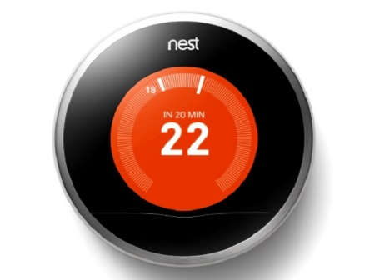
Introduction
Internet of Things (IoT) is the concept of connecting any device to the internet.
Advanced connectivity of devices, systems, and services that goes beyond M2M communications and covers a variety of protocols.
IoT Devices: Smart home device, Beacon device, Raspberry Pi, Amazon dash buttons, smart trackers, etc.
Department of Computer Science

Slide 4
Introduction
IoT applications like smart cities, smart energy management system, heart monitoring implants, etc.
Department of Computer Science

Slide 5
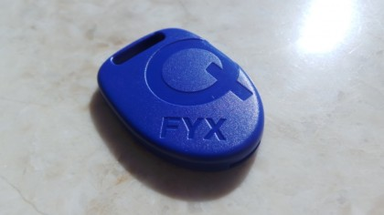
Introduction
What is beacon device?
Broadcast signal that can heard by smart devices.
Runs on a small batteries.
Bluetooth capable antennas.
Platform independent.
Beacon bluetooth range can be adjustable.
Mainly used for indoor location system
Affordable
Department of Computer Science

Slide 6
Introduction
How beacon works?
Send out signals using bluetooth low energy packets.
Application need to access the location.
Take beacon ID and ask application & OS to monitor beacon ID.
Mobile device sense the beacon and let know the application.
Application go back to server and it take action.
Department of Computer Science

Slide 7
Motivation
Implement indoor location system and appointment system in Android framework.
IoT applications are growing trend in the applications of healthy care, location system, connected cars, etc.
Multinational companies like Verizon, PayPal predict that by 2020, the internet of things will be connected up to 26 billion units.
Department of Computer Science

Slide 8
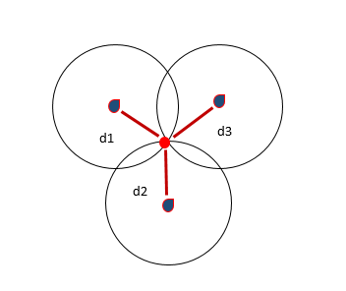
Related Work
Received Signal Strength Indicator (RSSI)
RSSI use to know the strength of signal.
RSSI help to set range of beacon device.
As per RSSI range we can make a function which can do different task at different range.
Measure in DBM (DeciBels below 1 Mill watt)
Department of Computer Science

Slide 9
Cont...
RSSI= A- (10nlog10d)
Where,
RSSI (Received Signal Strength Indicator) in dbm
A = transmission power of beacon,
n = path loss exponent (n can be deferent in indoor and outdoor it depends on the medium),
d =distance between beacon and mobile.
Department of Computer Science

Slide 10
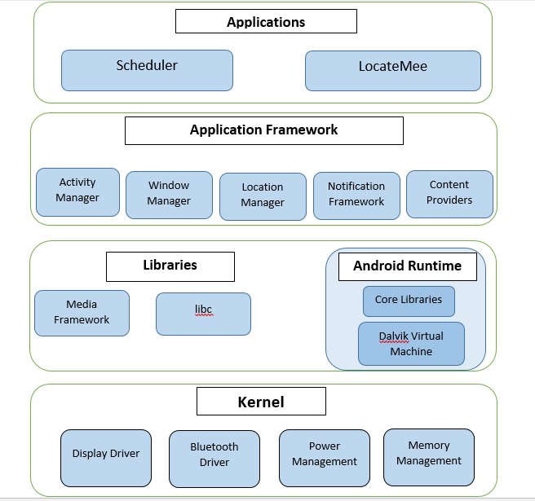
System Architecture
Department of Computer Science

Slide 11
Design & Implementation
Scheduler Application
Beacon is sense by application when the user arrives at the appointment office.
Application sends the information to the cloud server about beacon id and the location of beacon.
Now cloud server send notification to the user device about Appointment time and token number.
Our system can be implemented in any office environment where scheduling is required.
Department of Computer Science

Slide 12
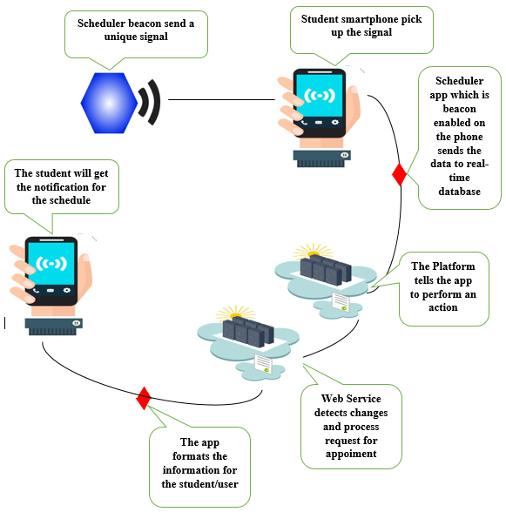
Design & Implementation
Scheduler Application
Department of Computer Science

Slide 13
Design & Implementation
LocateMee Application
Beacon sense by the user’s mobile application.
Application send notification to user with campus map.
We build this scenario for our Lamar University infrastructure.
Helpful to the user who visit Lamar University first time.
Department of Computer Science

Slide 14
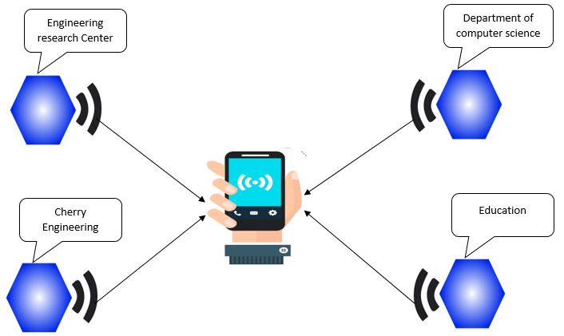
Design & Implementation
LocateMee Application
Department of Computer Science

Slide 15
Technologies
Front-end : Android Application
Language : JAVA , XML
Middleware : Web services
Language : Node.js
Database : Firebase Real-time Database
Language : JSON
Requirements : Bluetooth enabled Device , Web server with Node.js support
Department of Computer Science

Slide 16
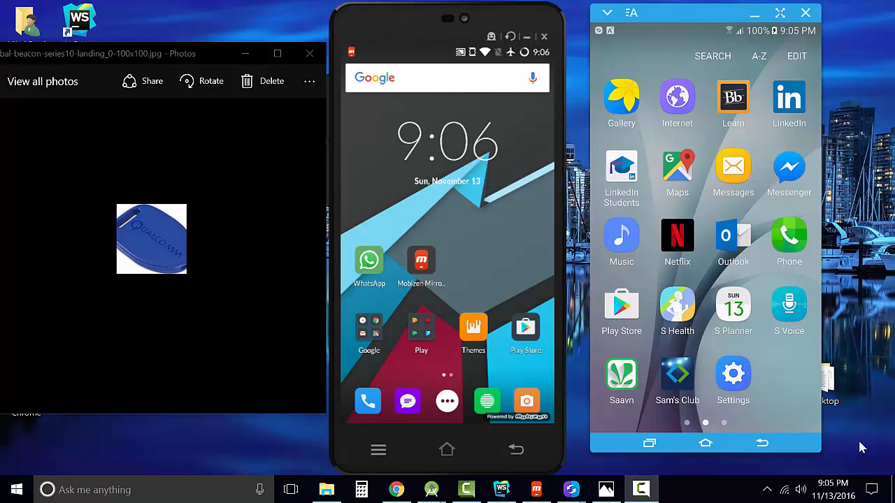
Project Demo
Department of Computer Science

Slide 17
Test Case
Scenario | Test Step | Expected result | Actual Outcome
Device with Bluetooth off | User arrives to bacon area with Bluetooth off device | No appointment will be scheduled | Application request users to turn on Bluetooth
Device with Bluetooth on | User arrives to bacon area with Bluetooth on device | appointment will be scheduled | Application detects neatest bacon and process request
2 or more Device arrives within few seconds difference | Multiple user arrives at bacon area with | Person arrives first should get first appointment | Person turn on Bluetooth first get first appointment
Department of Computer Science

Slide 18
Future Work
Implement user interface for adding time slots for user convenience in Scheduler application.
Implement LocateMee application for all building of University with details and another app for amusement park.
Build indoor navigation system for shopping mall.
Department of Computer Science

Slide 19
Conclusion
IOT allows objects to be sensed and/or controlled remotely across existing network infrastructure, this opportunity can be used to easily integrate physical word into computer-based systems , and which can lead to smart grids , smart transportation and smart cities.
We demonstrate small application using BLE bacon devices , which can be used in multiple ways to from making small decision to collecting large amount of data
Department of Computer Science

Slide 20
Bibliography
Oladayo Bello and Sherali Zeadally, “Intelligent Device-to-Device Communication in the Internet of Things,” IEEE SYSTEMS JOURNAL VOL. 10, NO.3 (September 2016).
Ola Salman, Sarah Abdallah, Imad H. Elhajj, Ali Chehab, and Ayman Kayssi, “Identity-Based Authentication Scheme for the Internet of Things,” 978-1-5090-0679-3, IEEE Symposium on Computers and Communication (2016).
http://www.ebay.com/
Rakesh K. Deore, Vijay R. Sonawane, and Pooja H. Satpute, "Internet of Thing Based Home Appliances Control," 978-1-5090-0076-0, International Conference on Computational Intelligence and Communication Networks (2015).
Ramaswamy Pillai Vinob Chander, "Web Services for the Internet of Things - A feasibility study," 2325-2944, International Conference on Distributed Computing in Sensor Systems (2016).
http://docs.gimbal.com/android/v2/devguide.html
Nomusa Dlodlo, Oscar Gcaba, and Andrew Smith, "Internet of Things Technologies in Smart Cities," 978-1-905824-55-7, International Information Management Corporation (2016).
SCharalampos Papamanthou, Franco P. Preparata, and Roberto Tamassia,"Algorithms for Location Estimation Based on RSSI Sampling,” Algosensors (2008)
Department of Computer Science

Slide 21

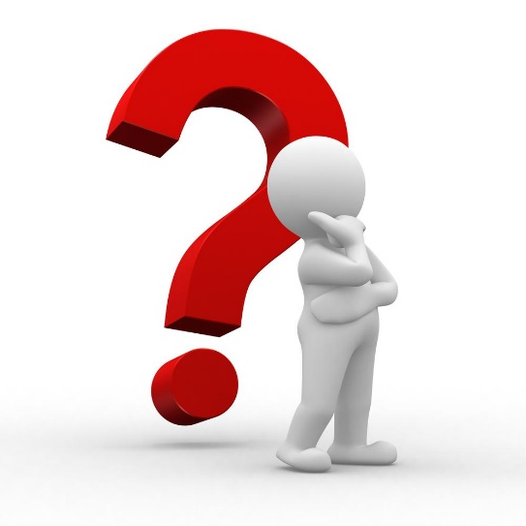
Department of Computer Science

